Slide 1

SmartGrid: Solving the Energy Trilemma with Quantum Optimization
Team Beerantum | Quantum Boost
Beerantum

Slide 2

The Energy Trilemma
Demand Response faces three competing pressures that simple algorithms cannot solve:
For Consumers
For The Grid
Expensive, unpredictable bills. Penalized for using energy during peak times like cooking dinner or charging cars after work.
The 6 PM demand spike stresses the system, risking blackouts and forcing utilities to use expensive, high-emission 'peaker' plants.
For The Planet
Gigawatts of clean solar and wind energy generated at 2 PM are lost forever, while we burn fossil fuels hours later.
Beerantum

Slide 3
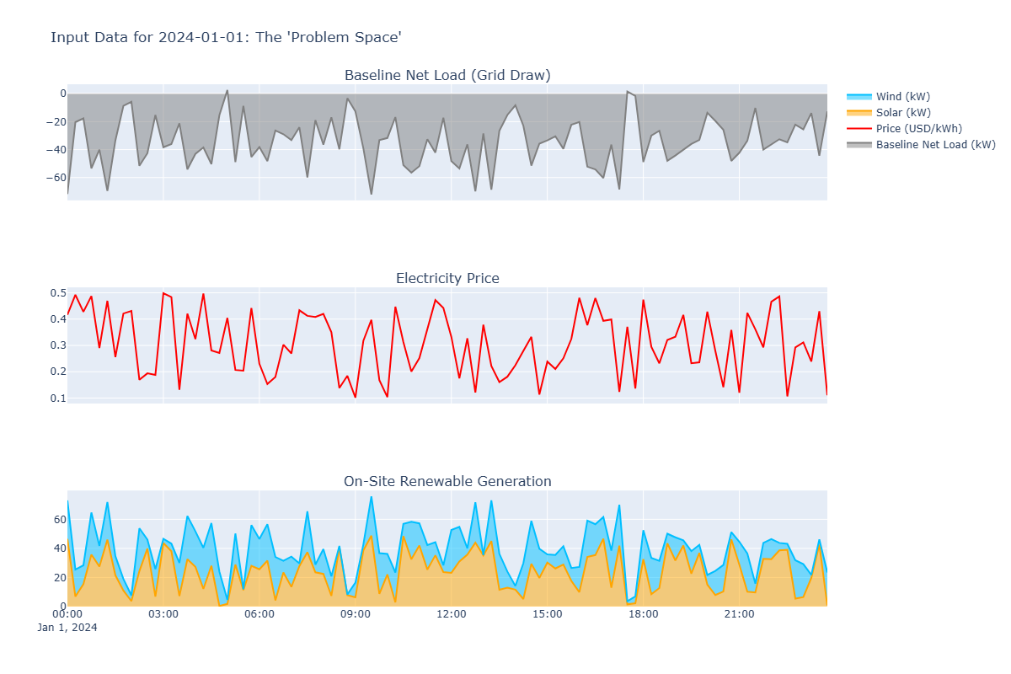
The Battlefield: Digitizing the Problem
We created a high-resolution digital twin of a home's 24-hour energy environment using 96 time steps (every 15 minutes):
EV Charger
Baseline Load (Bt): Non-negotiable power consumption
1
4-hour block, overnight only
Energy Price (Ct): Volatile 15-minute utility costs
Renewable Generation (Rt): Free on-site solar and wind energy
Washing Machine
Three controllable appliances with unique constraints create a massive search space of 2101 possibilities.
2
1-hour block, daytime only
Dishwasher
3
1.5-hour block, evening/early morning
Beerantum

Slide 4
Building the Digital Brain: QUBO Translation
We speak the native language of quantum annealers: QUBO (Quadratic Unconstrained Binary Optimization). Our goal: build a single cost function representing a vast energy landscape where the lowest valley is the optimal schedule.
01
02
03
Digitize Choices
Set The Dials
Build Cost Landscape
Translate 101 possible start times into binary 'on/off' switches (xi ∈ {0, 1})
Balance objectives with hyperparameters: A (Cost) = 0.5, B (Peak) = 3.0, C (Constraint) = 100,000
Create QUBO matrix Q with three layers: cost terms, constraint penalties, and 2,327 grid-aware interactions
Beerantum

Slide 5
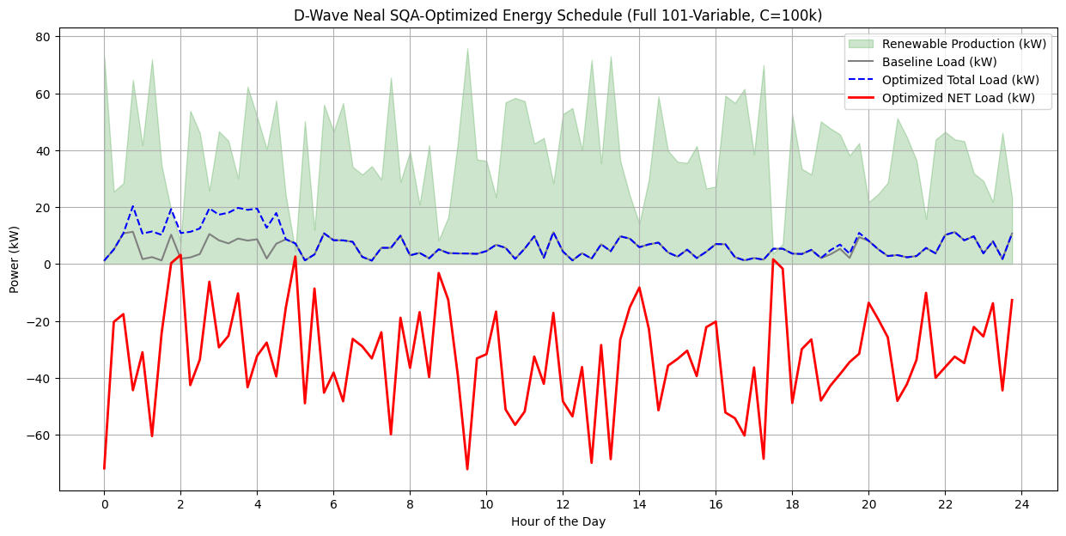
The Solve: Finding the Answer
We unleashed the D-Wave SimulatedAnnealingSampler to explore the 2,327-interaction QUBO landscape.
Optimal Schedule
EV Charger: Start at 00:45 AM
Washing Machine: Start at 7:00 PM
306.5
Dishwasher: Start at 03:15 AM
Solution validated: constraint perfectly satisfied.
Seconds
To solve the entire 24-hour, 101-variable problem
$55.57
Final Cost
Rock-bottom price with Grid-First priority
Beerantum

Slide 6
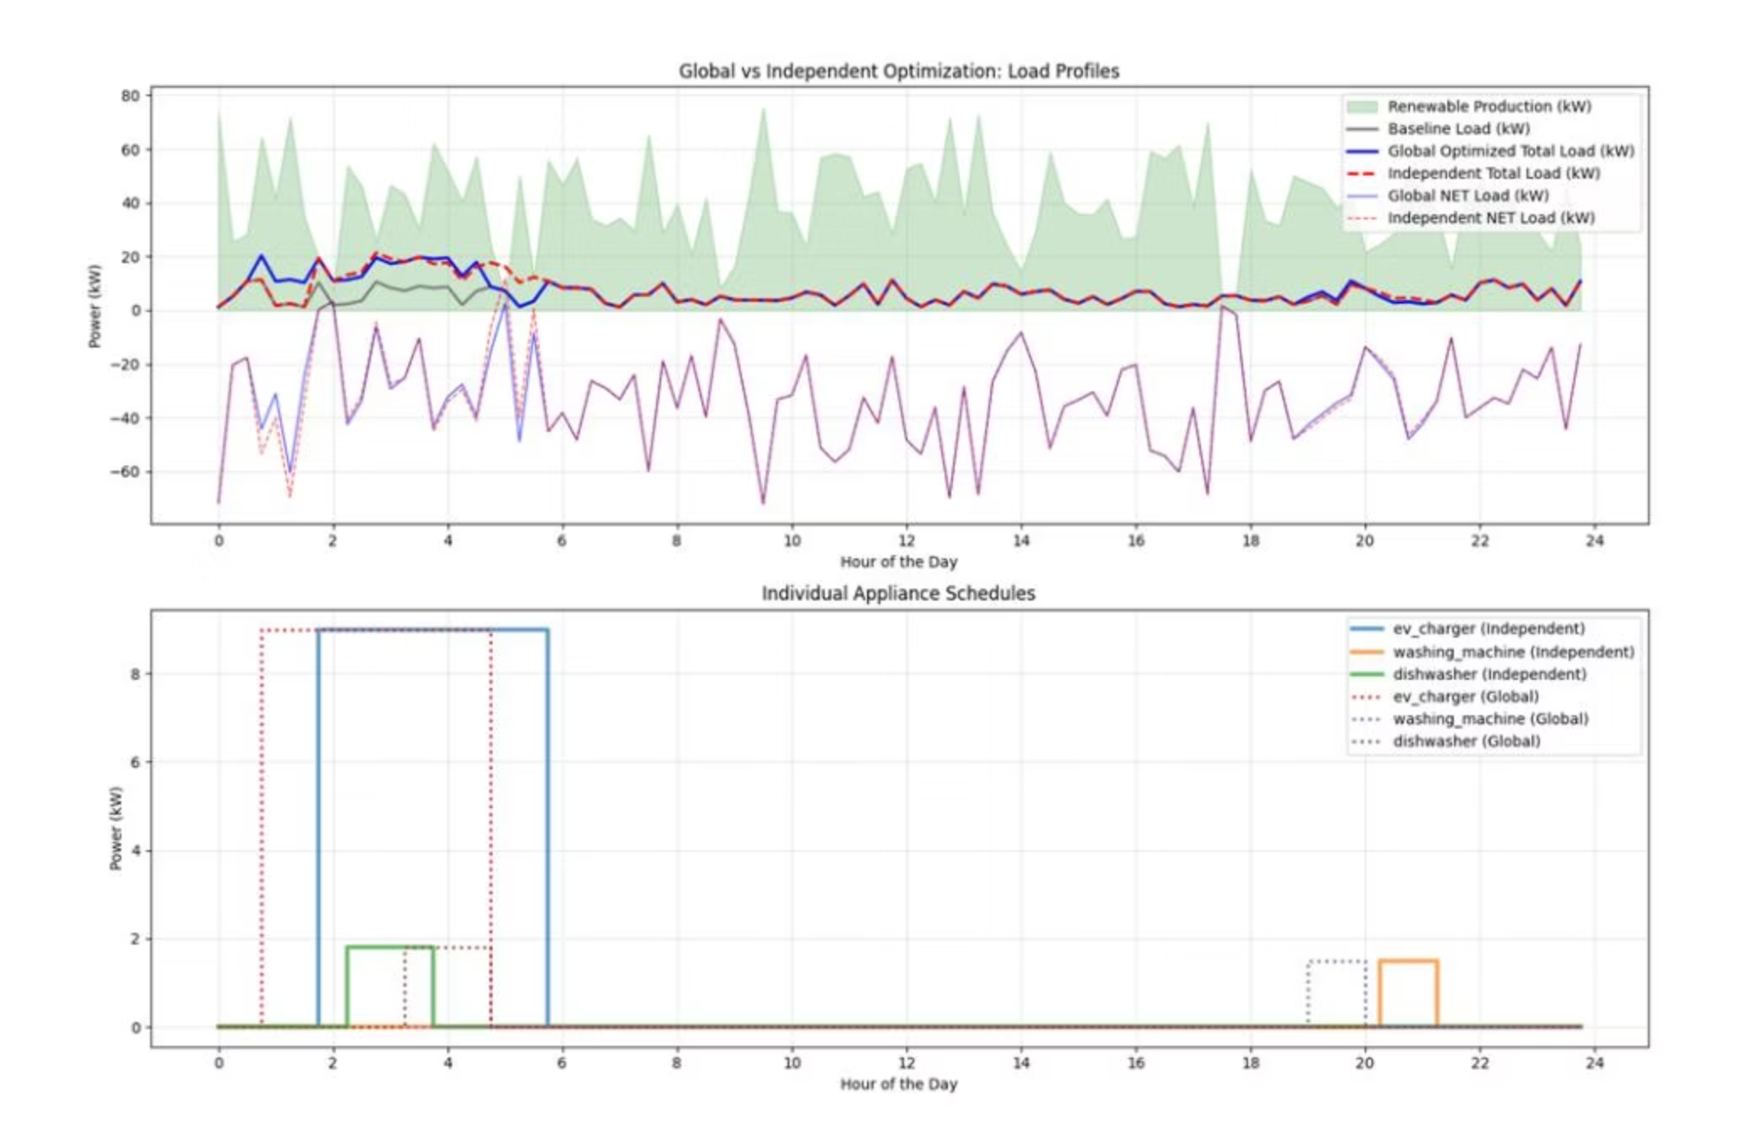
The Greedy Trap vs. Global Intelligence
To prove our Grid-Aware QUBO's power, we built a naive "greedy" algorithm that solves three independent problems instead of one connected system.
Metric
Global (Ours)
Greedy
Total Cost
$55.57
$50.48
Peak Net Load
3.18 kW
11.63 kW
Peak Reduction
73%
Grid disaster
Beerantum
The greedy algorithm created a massive 8.44 kW surge by stacking appliances at the cheapest time—the exact opposite of Demand Response.

Slide 7
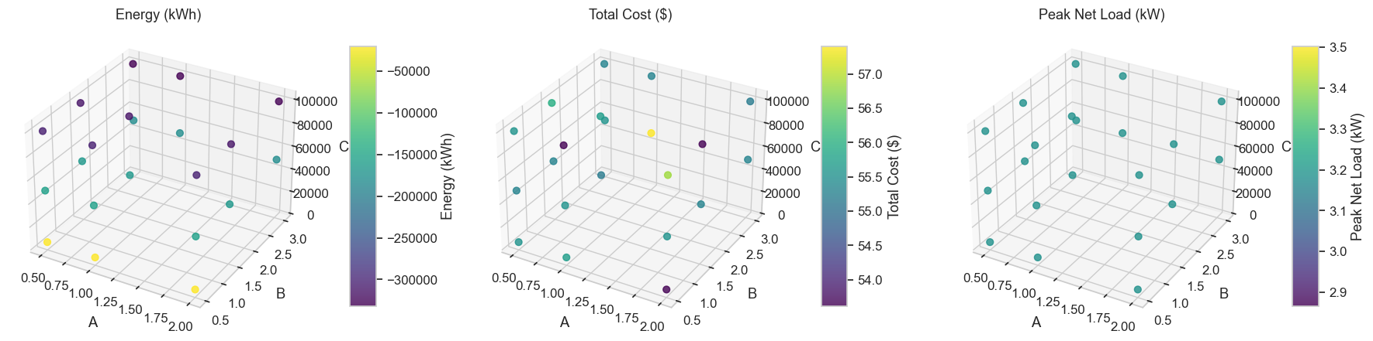
Hyperparameter Optimization: Proving Our Dials
We performed a rigorous 3D hyperparameter sweep testing 27 combinations to find the statistically best (A, B, C) settings.
C = 100,000
B = 3.0
Achieves lowest-energy, most effective solutions with unbreakable constraint enforcement
Prioritizing peak load is the single most important factor in finding optimal solutions
Data-Driven Winner
A=0.5, B=3.0, C=100,000 yields 3.18 kW peak at $55.31—statistically proven optimal
Beerantum

Slide 8

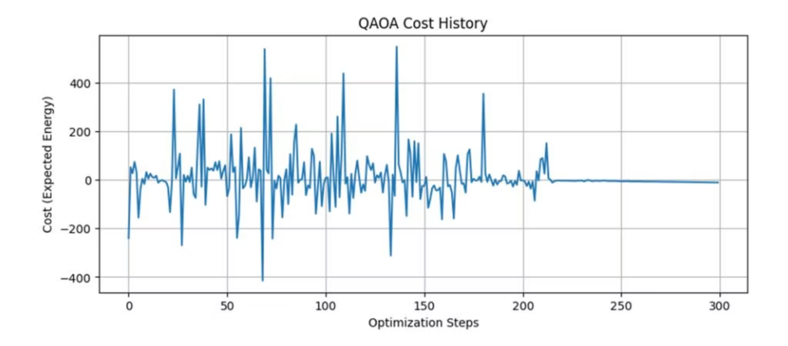



True Quantum: The QAOA Approach
Our second solution builds a true quantum algorithm from scratch using PennyLane—designing the quantum circuit itself.
Pruning for Simulation
Reduced to 27-qubit problem while preserving core complexity
Ising Hamiltonian
Translated QUBO to 27-qubit, 154-interaction quantum system
JAX-Powered Circuit
Built p=2 layer QAOA with auto-differentiation and JIT compilation
Hybrid Training
300-step ADAM optimization in 29.9 minutes
Beerantum

Slide 9

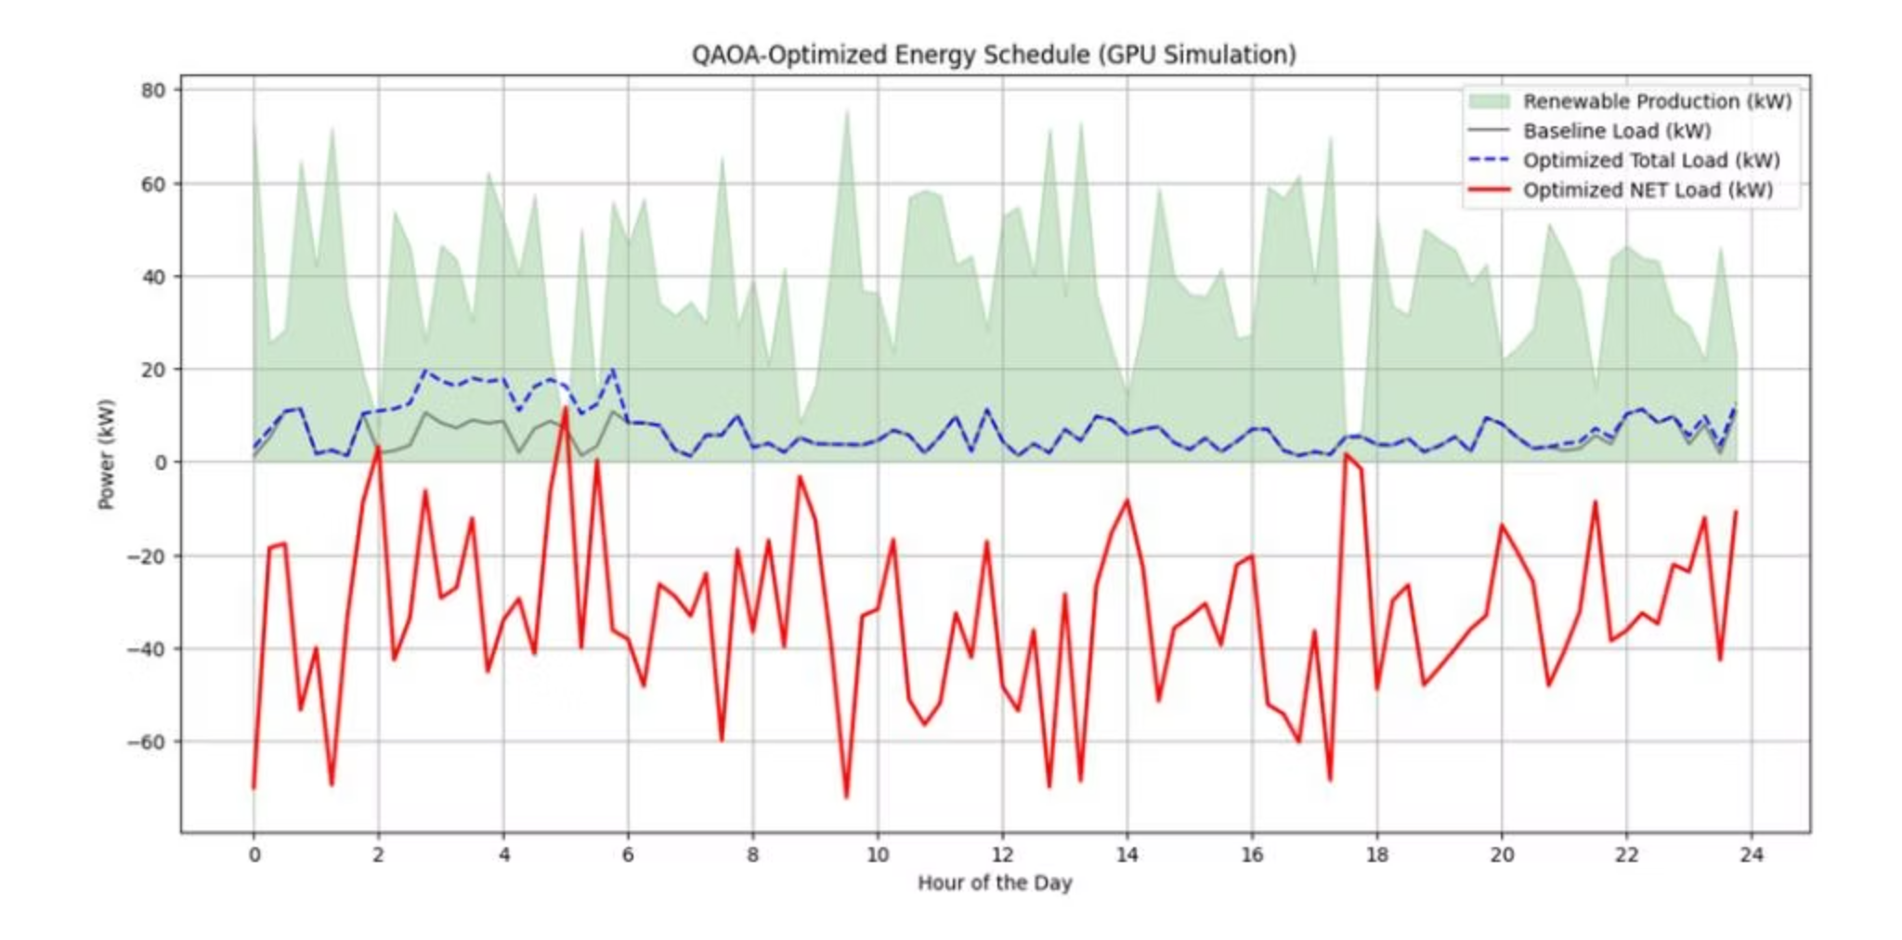

The Critical Insight: A "Broken" Constraint
Our QAOA broke the constraint—but this isn't failure, it's our most profound insight.
The optimizer found a loophole: with C=50 (far too low), it achieved lower energy by ignoring the small penalty rather than solving the complex peak-load problem.
This demonstrates the central challenge of quantum optimization and gives us a clear, data-driven direction.
15
Ones in Output
Should be exactly 3
$172.40
Chaotic Cost
Result of C=50 being too low
Beerantum

Slide 10

A Two-Part Victory
We deliver complete solutions for today and tomorrow:
Solution for TODAY
Production-ready Grid-Aware QUBO: 73% more effective at stabilizing the grid. Peak load of 3.18 kW at $55.31—the definitive hackathon solution.
Model
Cost
Peak Load
Constraint Valid?
Greedy (Baseline)
$50.48
11.63 kW
Yes
Global QUBO (Winner)
$55.31
3.18 kW
Perfect
QAOA (Future)
$172.40
N/A
Critical Insight
Team Beerantum | Project Repository Link
Beerantum

